Slide 1

TEAM CLOUD CROWD (AICBI-CC03)
Final Project

Slide 2
PROJECT TITLE
Deploying Static Website In Cloud.

Slide 3
PROBLEM STATEMENT
Many people are worried about their life and work pressure in office leads to stress. To overcome this we need motivational quotes to boost our mental health.

Slide 4
PROJECT OVERVIEW
This generator is a simple interesting project which is simply in HTML, CSS, and JavaScript. Here, the user has to click on Show another quote button and the quotes will appear with change in its background color. Also, this project includes a lot of JavaScript for making validations to certain parts of the project. And as our project is about cloud computing....add info about it ..and deployment models, etc.

Slide 5
WHO ARE THE END USERS
Someone who for looking some motivational, inspirational, and beautiful quotes. To make life more beautiful and happy.

Slide 6
YOUR SOLUTION & ITS VALUE PROPOSITION
Inspiring and motivational quotes, which will influence and bring understanding into the soul of the reader.
Cloud deployment is capable of handling immense server load effortlessly. Hence, our website is deployed on cloud , as it makes use of centralized management of network services and servers, which makes things very easy to manage and ensures impeccable operation without compromising on anything. And the pay-as-you-go aspect of cloud adds to the benefit.

Slide 7
THE WOW IN OUR SOLUTION
It's the simplicity and intuitiveness of our website which makes it easy to use and access, as user experience is an important aspect to take into account while developing something. The design is very straightforward and the user's won't get confused, keeping the website simple, relevant, and interesting.

Slide 8
MODELLING
Project modelling creates a streamlined planning. As our project is about deploying a static website on cloud. We started with creating the website start with the design of the project i.e. the interface and then the coding where HTML and CSS part was completed first and then JavaScript. After successful testing of the website it was deployed on cloud. Where each step was modelled accordingly and effectively.

Slide 9
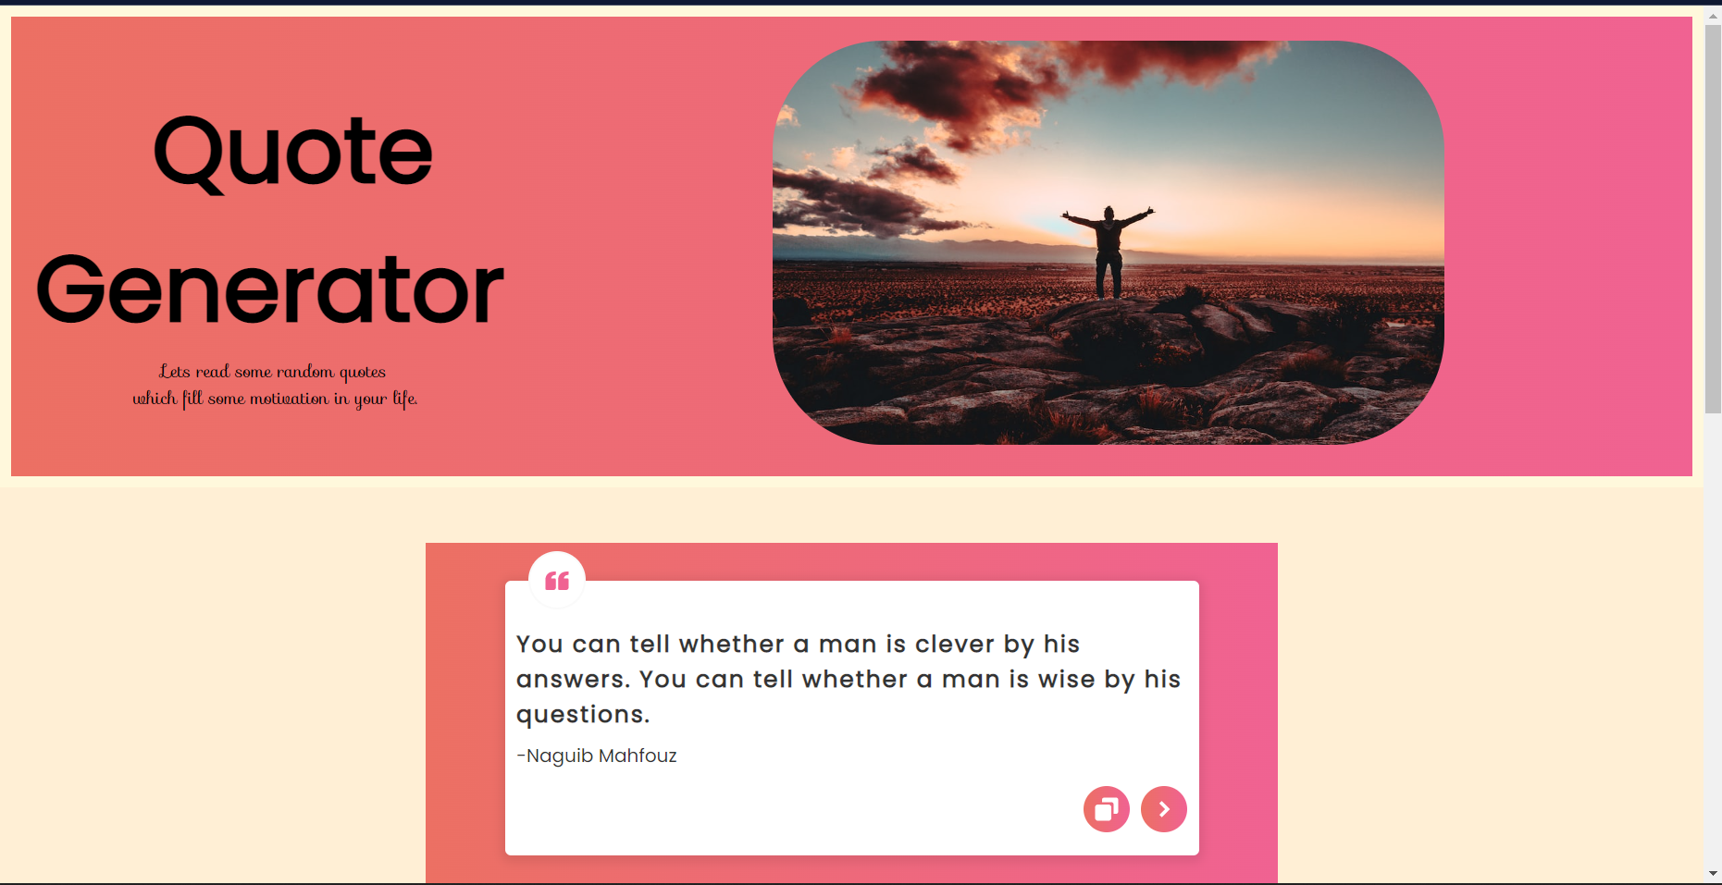
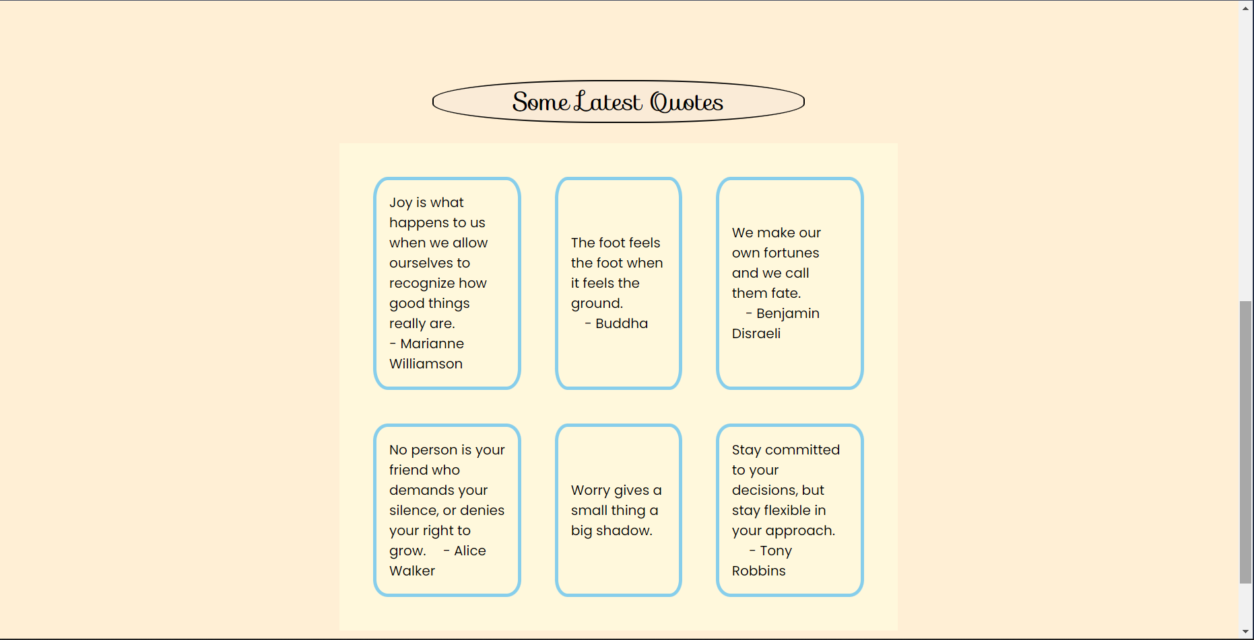
RESULTS

Slide 10
Meet Our Team
Pradeesh Kumar R
Dipti Yuvraj Bhosale
Sagar Gupta

